Slide 1
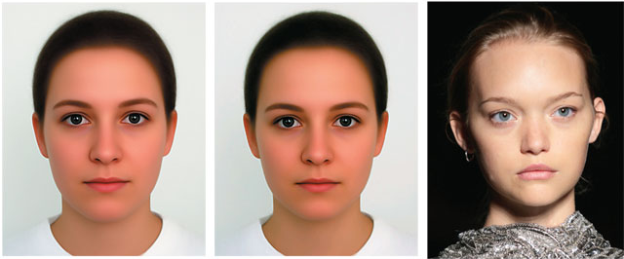
Attraction, Arousal, and Response

Slide 2
Chapter 5: Attraction, Arousal, and Response
  Sexual Attraction: It Takes Two
  Sexual Arousal Has Multiple Roots
  Sexual Arousal Follows a Response Cycle

Slide 3
Sexual Attraction: It Takes Two
What is beauty?
  Masculinity–femininity is an important dimension of attractiveness.
  Babyfacedness is sometimes considered attractive.

Slide 4
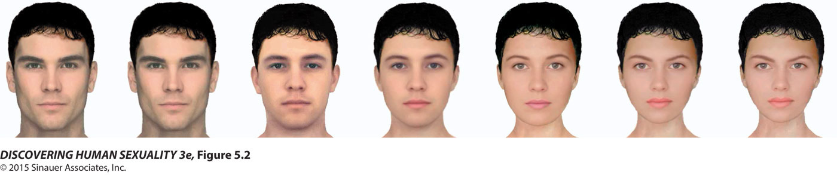
Figure 5.2 The face that changes sex

Slide 5

Figure 5.3 Babyfacedness increases attractiveness

Slide 6
Sexual Attraction: It Takes Two
  The more symmetrical a person’s face, the more attractive, sexy, and healthy they are perceived to be.
  Symmetry increases the perceived attractiveness of bodies as well.

Slide 7
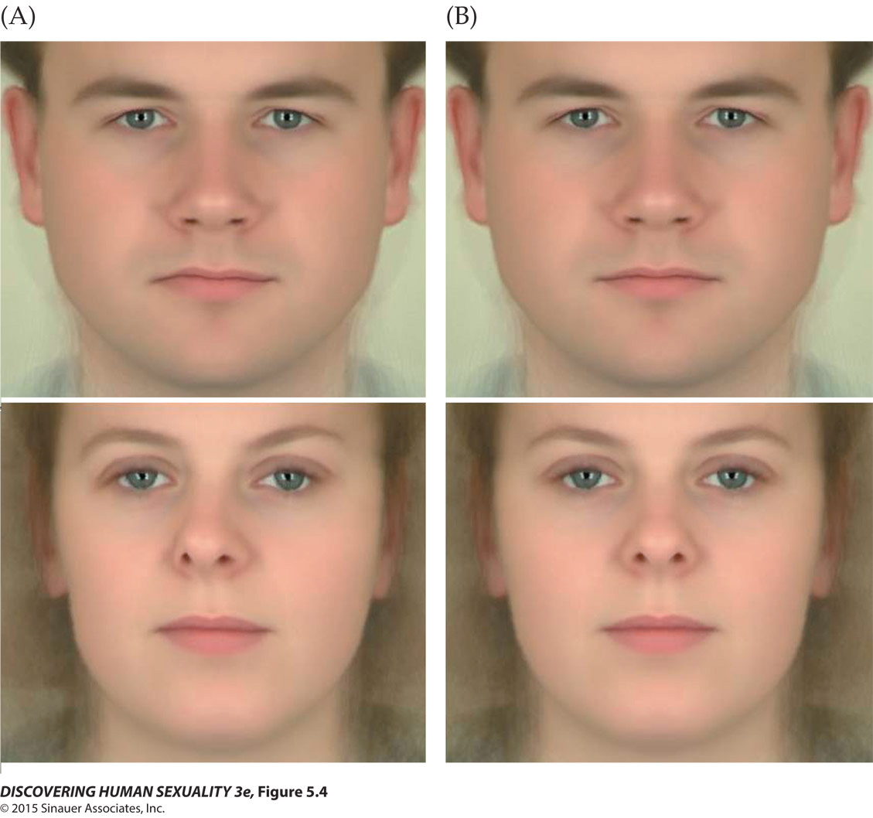
Figure 5.4 Symmetry increases attractiveness

Slide 8
Sexual Attraction: It Takes Two
  Relative slimness or fatness (body mass index) often influences judgments of attractiveness.
BMI preferences are generally culturally determined.

Slide 9
Sexual Attraction: It Takes Two
For women, a “healthy” BMI is between 18.5 and 25.
  Male and female raters in U.S. and Western cultures show a preference for females at the low end of this range (18–22).
  Rural Zulus in South Africa, viewing the same images, gave the highest ratings to women with BMIs of 20 to 40.

Slide 10
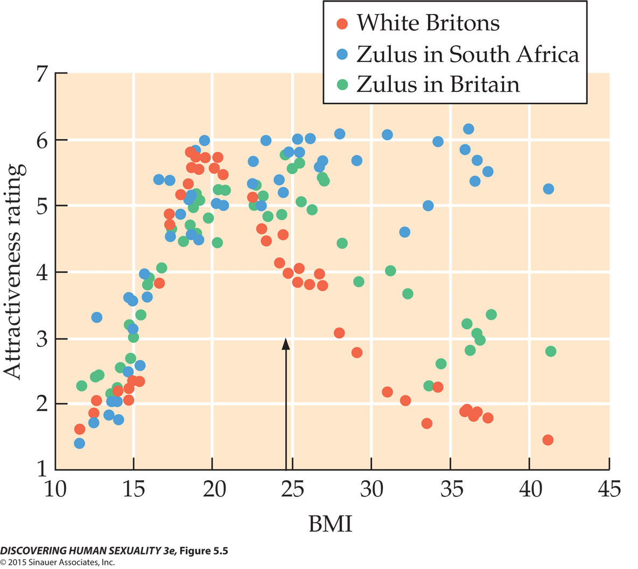
Figure 5.5 Body mass index and beauty

Slide 11
Sexual Attraction: It Takes Two
The waist-to-hip ratio is related to BMI.
Women judge men, in all weight categories, with a WHR of 0.9 to be the most attractive.

Slide 12
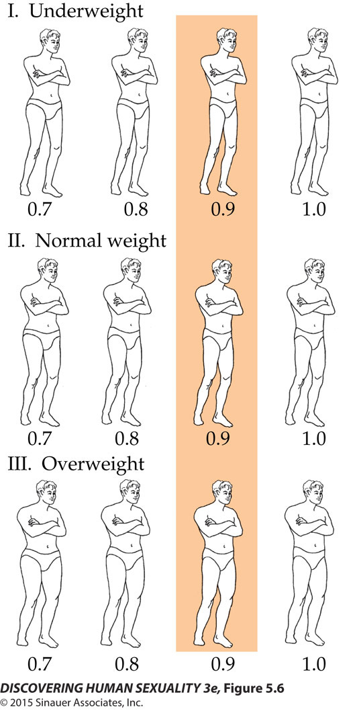
Figure 5.6 Waist-to-hip ratio and attractiveness

Slide 13
Sexual Attraction: It Takes Two
Culture also determines preferences for attributes like breast size and other body features.
People generally find faces of people from their own ethnic group more attractive than faces from other groups, although individuals in different cultures rely on similar cues to determine attractiveness.

Slide 14
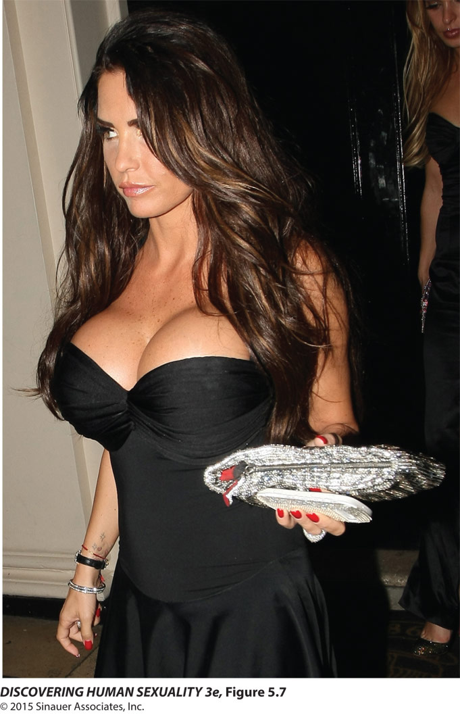
Figure 5.7 Improving on nature

Slide 15
Sexual Attraction: It Takes Two
Women perceive men with deeper voices to be more attractive.
Men perceive women with higher-pitched voices to be more attractive.
Unconscious olfactory mechanisms may also influence sexual arousal.
Personality traits such as trustworthiness, warmth, and humor are perceived as attractive.

Slide 16
Sexual Attraction: It Takes Two
The mere fact of having seen a face before makes us judge it as more attractive than if we are seeing it for the first time.
Coolidge effect: The revival of sexual arousal caused by the presence of a novel partner.
Habituation affects sexual relationships, leading to less sexual satisfaction as the duration of a relationship increases.

Slide 17
Sexual Attraction: It Takes Two
Women are more attracted to more masculine faces and deeper voices around the time of ovulation.
Men tip female “lap dancers” more near the women’s time of ovulation.

Slide 18
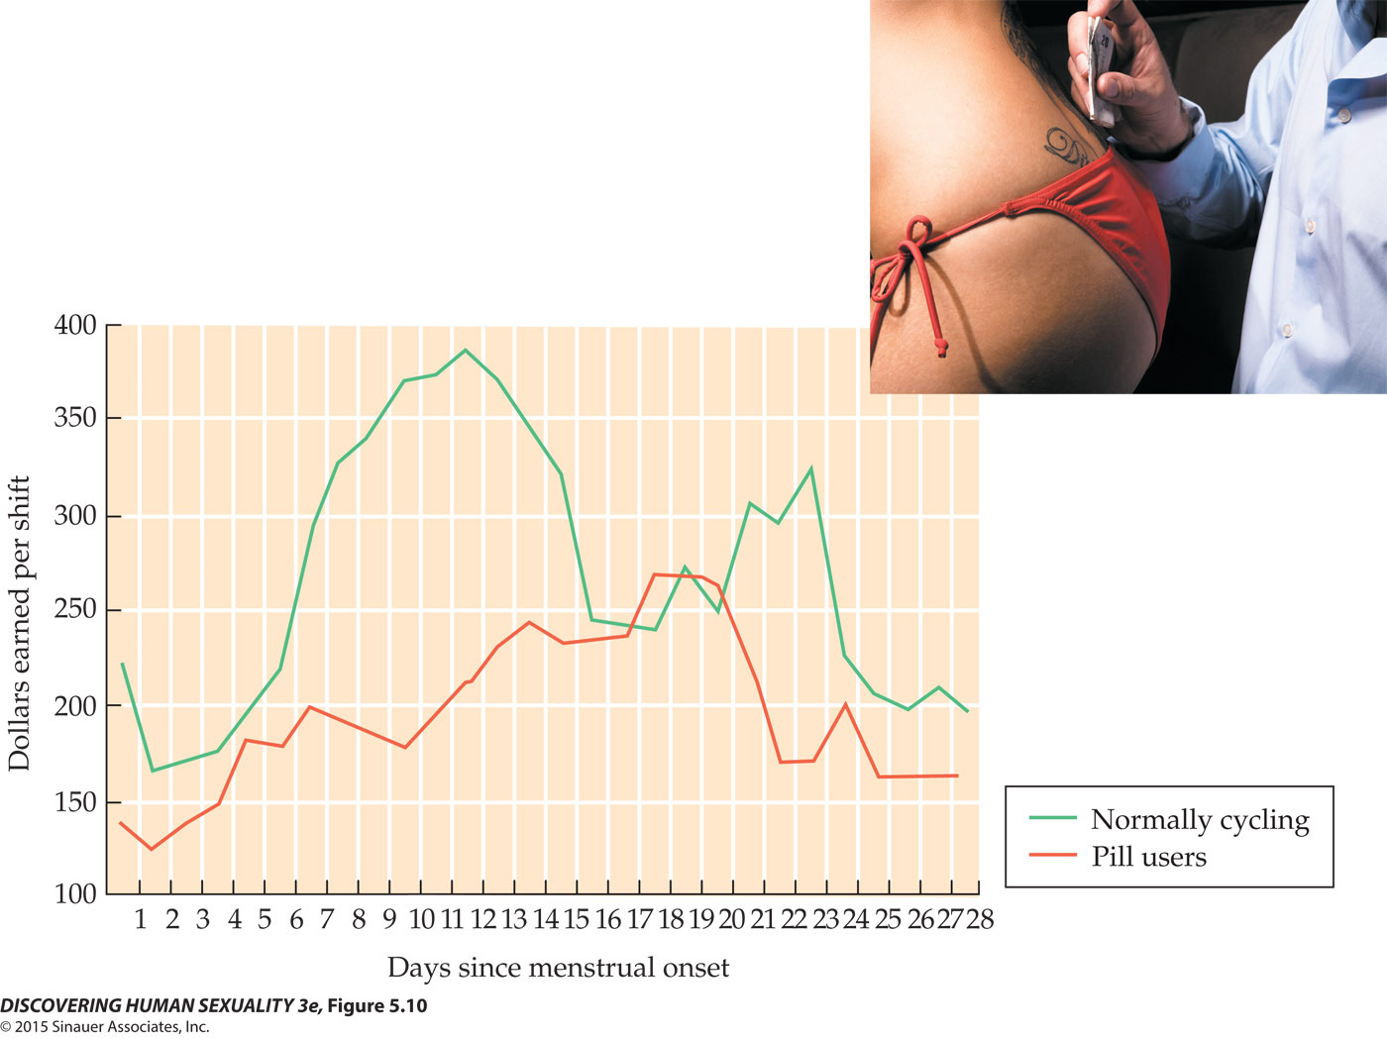
Figure 5.10 Lap dancers’ earnings

Slide 19
Sexual Attraction: It Takes Two
Asexuals may still experience romantic attraction and desire for psychological intimacy.
This experience is unrelated to sexual performance and physiological function.

Slide 20
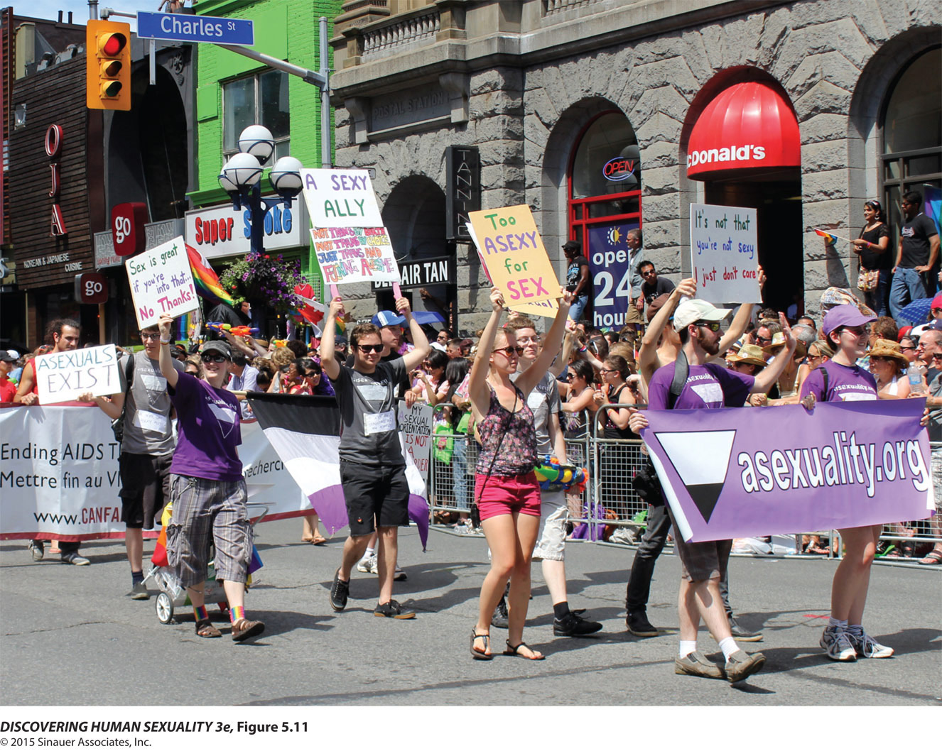
Figure 5.11 Asexual pride

Slide 21
Sexual Arousal Has Multiple Roots
Sexual arousal may arise from external stimuli, such as the presence or behavior of a sexually attractive individual, or it may arise entirely from within, as a result of sexual fantasies.
Fantasy promotes sexual arousal.
  Men spend more time having sexual fantasies than women do.
  The content of fantasies varies a great deal.

Slide 22
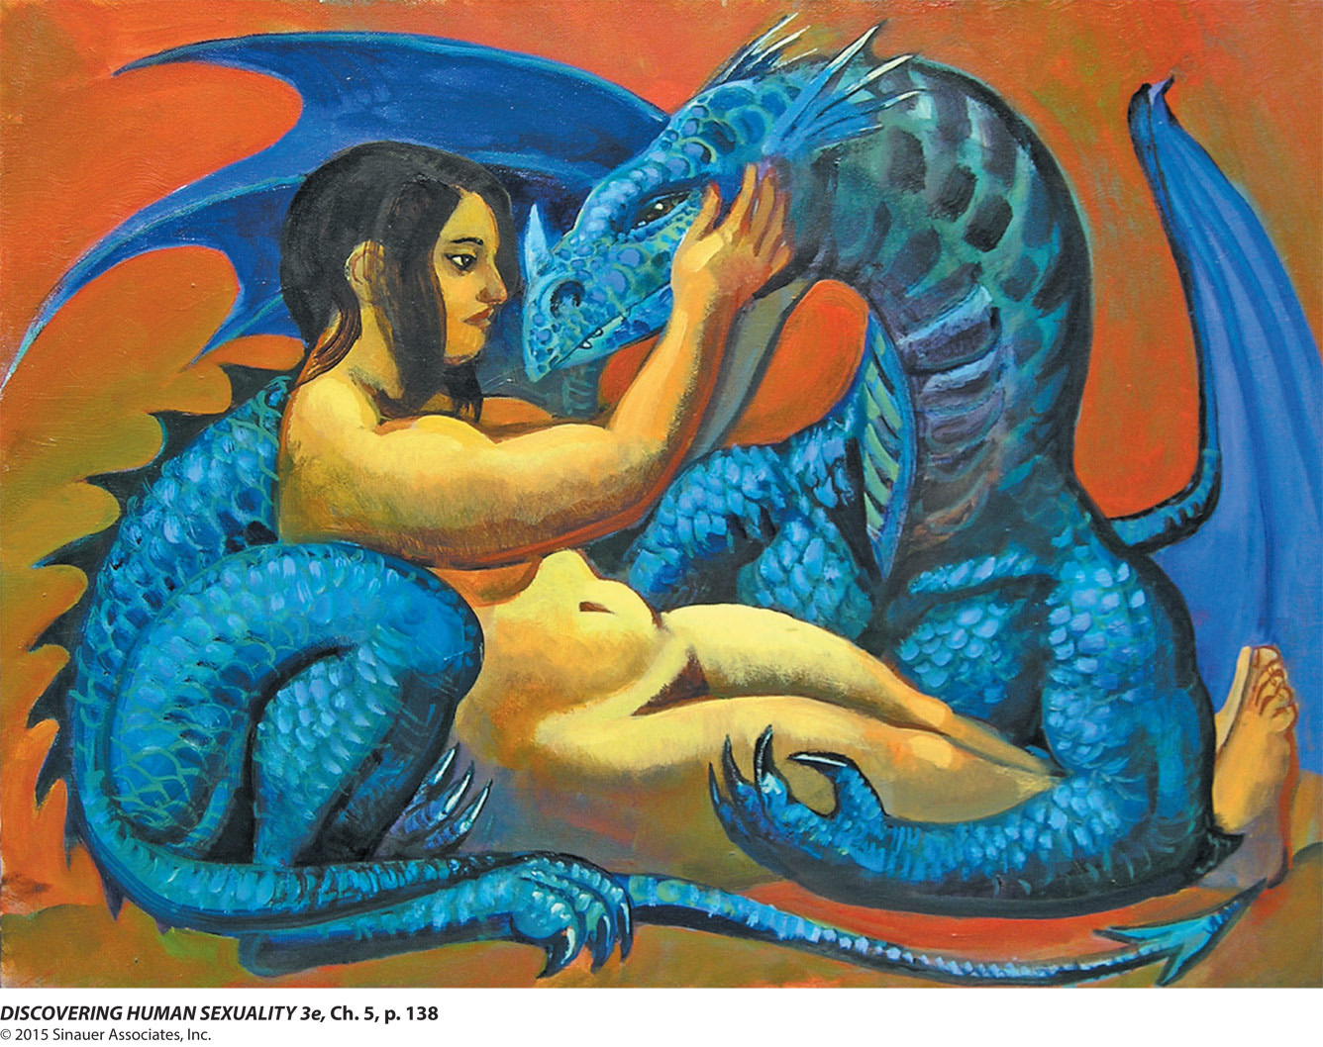
Photo, p. 138 In your fantasies you can have sexual experiences that might not be advisable in real life

Slide 23
Sexual Arousal Has Multiple Roots
Fantasies allow exploration of sexual experiences that might not be advisable in real life.
Women’s rape fantasies are not scenarios women would like to engage in.

Slide 24
Sexual Arousal Has Multiple Roots
Activity in the anterior cingulate cortex, a portion of the brain that is also activated by other emotionally rewarding stimuli, is associated with sexual arousal.

Slide 25
Sexual Arousal Has Multiple Roots
Testosterone influences arousability in boys and girls entering puberty.
The levels of testosterone in most adult men are usually high enough to have little effect on arousability, although a large reduction in testosterone can affect sexual desire and activity.
Both testosterone and estrogen influence sexual activity in women.

Slide 26
Sexual Arousal Has Multiple Roots
Many substances from plants and animals thought to be aphrodisiacs may work, but only through the power of suggestion.
Certain recreational drugs can influence arousal but may impair judgment and pose health hazards.
Conditioning influences sexual arousal.

Slide 27
Sexual Arousal Follows a Response Cycle
The best-known model, developed by Masters and Johnson, is divided into four phases:
  Excitement
  Plateau
  Orgasm
  Resolution

Slide 28
Sexual Arousal Follows a Response Cycle
The excitement phase occurs when sexual arousal begins.
  Women: increased blood flow to labia, erection of clitoris and nipples, vaginal lubrication
  Men: erection of penis and elevation of testicles
Notes:
Mara, do you really want 5.14 and 5.15 again here?

Slide 29
Sexual Arousal Follows a Response Cycle
The plateau phase is the period when sexual arousal is maintained.
  Women: increased muscular tension in outer third of vagina and surrounding muscles
  Men: may have secretions of fluid from bulbourethral glands, penis more erect, testicles further elevated

Slide 30
Sexual Arousal Follows a Response Cycle
Orgasm is the subjective experience of pleasure and release at sexual climax.
  Brief sequence of muscle contractions in genital and surrounding areas
  Heart rate, respiration, and blood pressure reach peak levels
  Accompanied by emission and ejaculation in men

Slide 31
Sexual Arousal Follows a Response Cycle
  Activity decrease in cognitive centers of the cerebral cortex; activity increase in “pleasure centers” of the brain, such as the nucleus accumbens
  Multiple orgasms are possible
  Orgasm is accompanied by a release of oxytocin, increasing the pleasurable quality of the orgasm

Slide 32
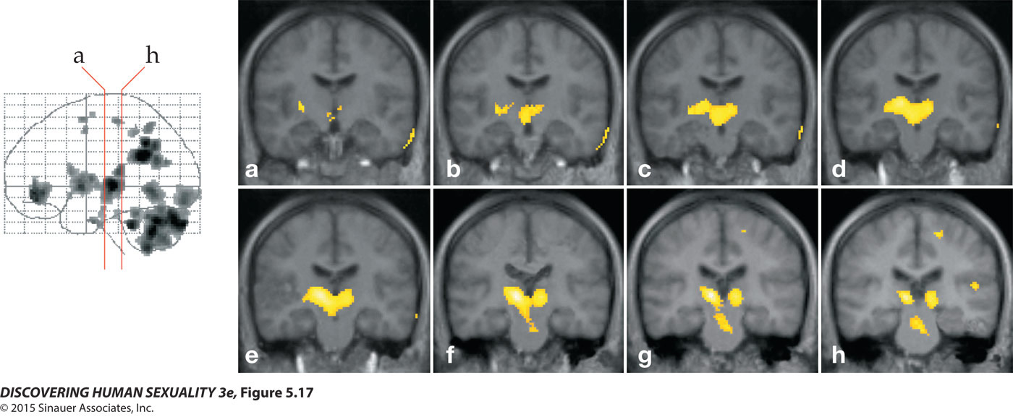
Figure 5.17 Brain activity during orgasm

Slide 33
Sexual Arousal Follows a Response Cycle
Physical signs of sexual arousal subside during the resolution phase.
  Erections and muscles relax
  Heart rate and blood pressure return to normal
Resolution typically takes about 15 minutes, more slowly if an orgasm has not occurred.

Slide 34
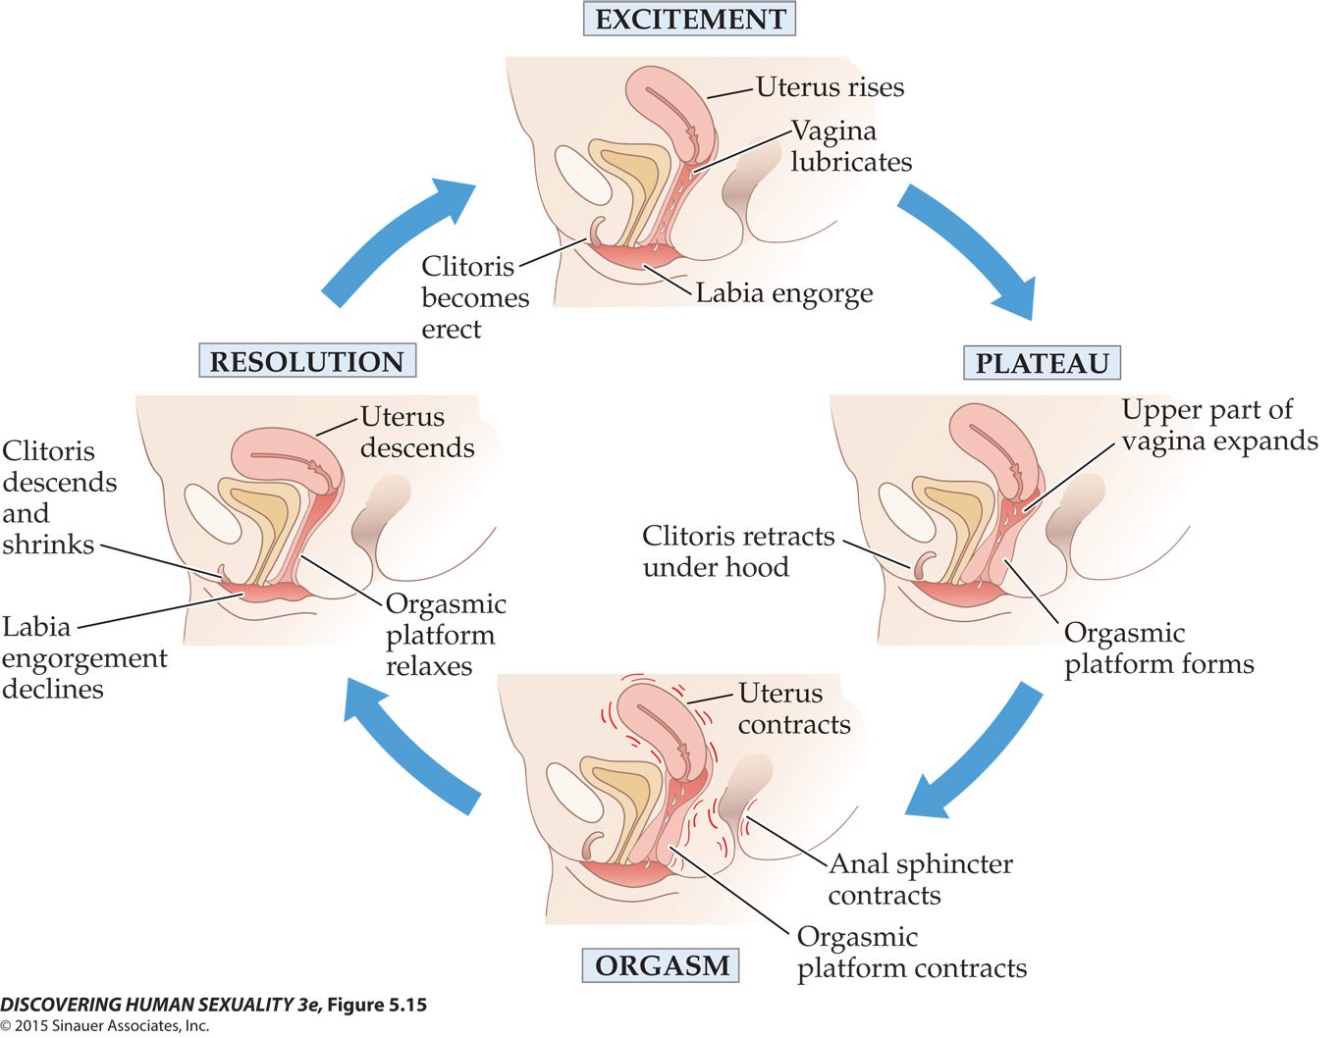
Figure 5.15 Genital changes in women

Slide 35
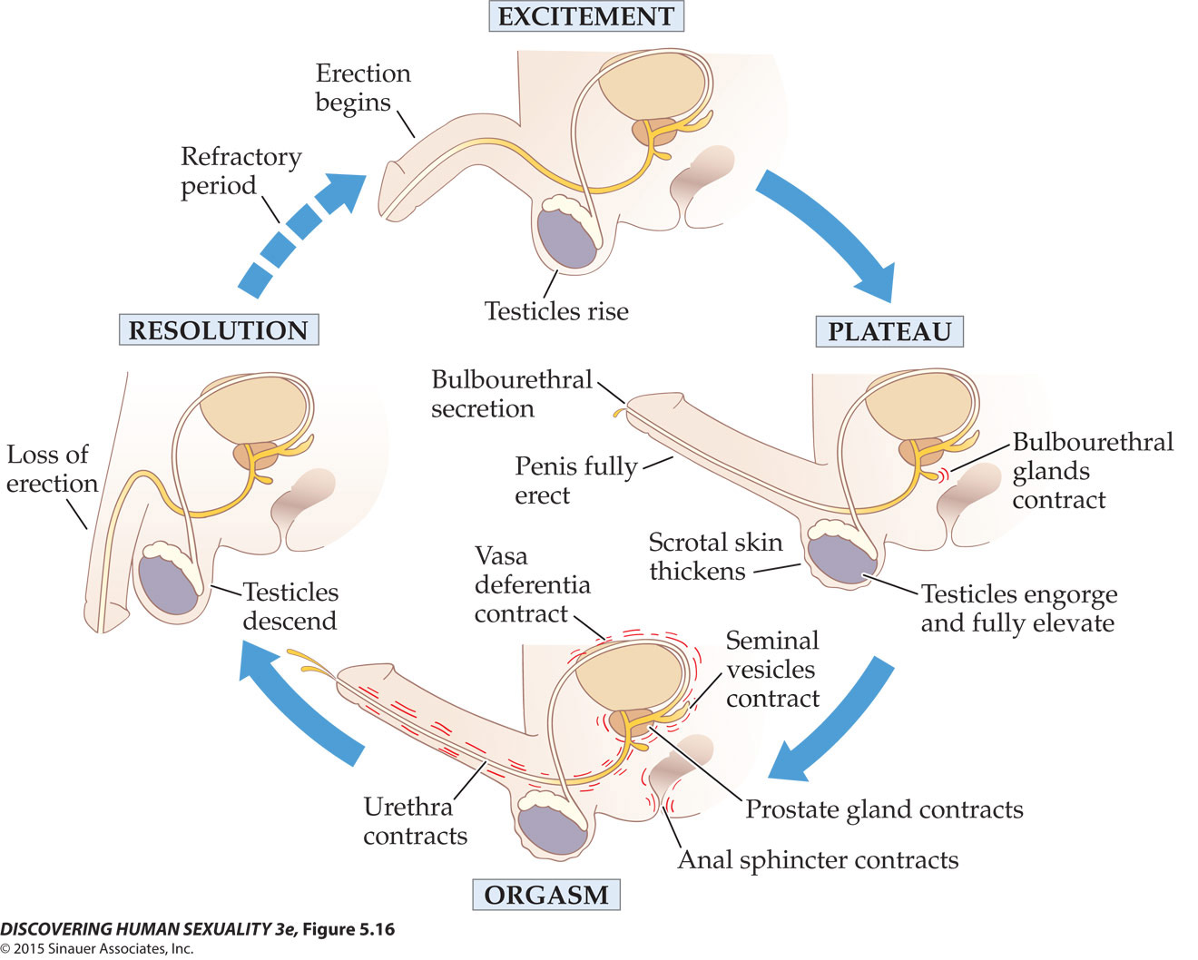
Figure 5.16 Genital changes in men

Slide 36
Sexual Arousal Follows a Response Cycle
The phases of the sexual response cycle may be linked in different ways for different people.
In some cycles, the orgasm phase is skipped.
In other cycles, there are multiple orgasms—two or more orgasms that follow without descent into the plateau phase.

Slide 37
Sexual Arousal Follows a Response Cycle
Men experience a refractory period, lasting between 30 and 90 minutes.
  The early part may be absolute—the man cannot be physiologically aroused by any means
  During the relative refractory period, strong stimuli or a novel sex partner may arouse the man

Slide 38
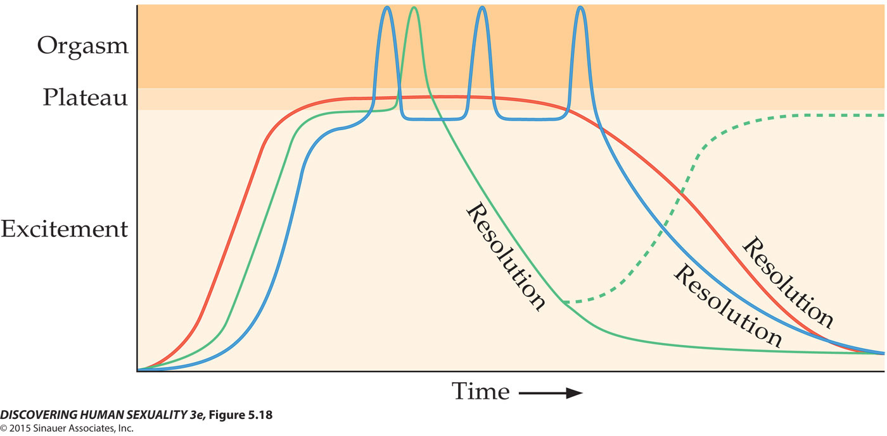
Figure 5.18 Patterns of sexual response

Slide 39
Sexual Arousal Follows a Response Cycle
Masters and Johnson’s model focuses solely on physiological markers of sexual arousal; it does not address the psychological components of arousal and desire.

